Slide 1












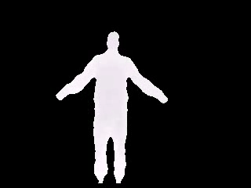
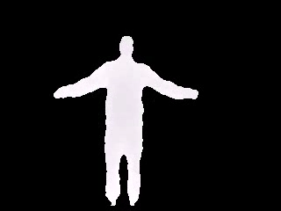




Slide 2


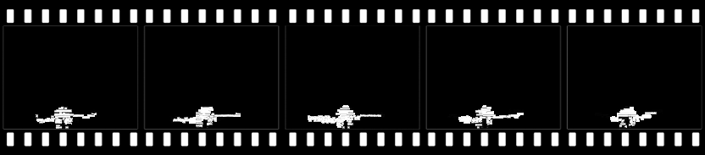
Depth maps 1

Slide 3

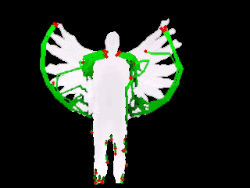


Y
X
Z

Slide 4
Depth maps 1
… …
Depth maps m
Projection
2D transformed videos
2D transformed videos
Front
Side
Top
Front
Side
Top
Feature Extraction
Dense trajectories
Codebook
Bag-of-Words model
Codebook
Codebook
Quantization
Hard-assignment
Histogram database
Training/Tesing using SVM
Histogram Intersection kernel,
One-vs-All strategy
Classifiers

Slide 5
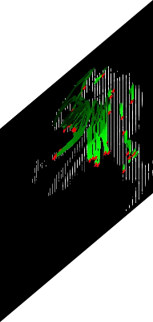
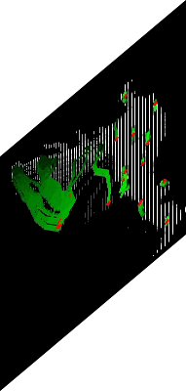
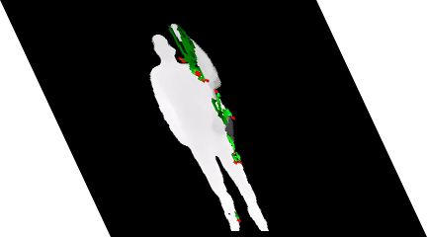
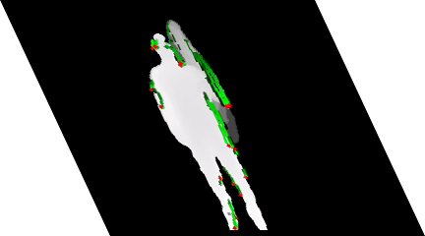
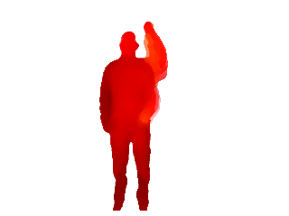
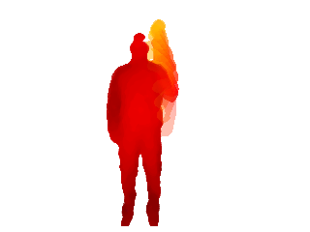
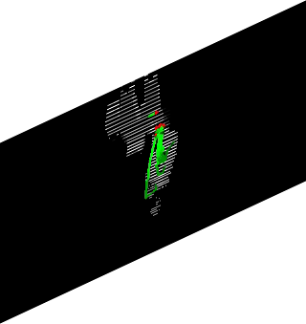
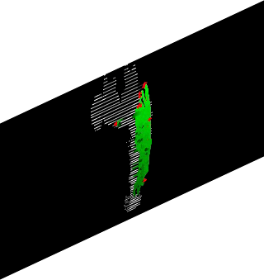
Y
Y
Z
X
Z
X

Slide 6
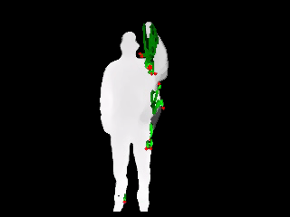
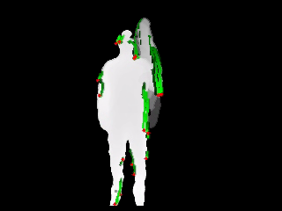
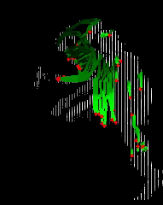
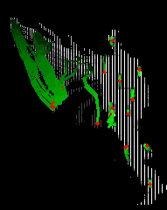
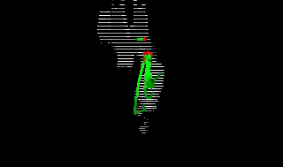
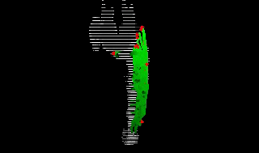
Y
X
Confused
motion
Y
Z
Unconfused
motion
Z
X
Unconfused
motion

Slide 7
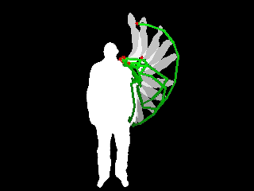
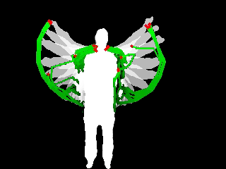
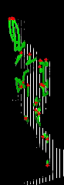
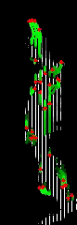


Y
FRONT
X
Discriminative
motion
Y
SIDE
Z
Similar motion
Z
X
TOP
Discriminative
motion

Slide 8
FRONT
Unconfused
motion
SIDE
Confused motion
TOP
Unconfused
motion
High arm wave
Two hand wave

Slide 9




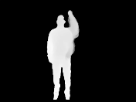


















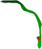



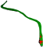


…
Depth maps 1
Depth maps M
Projection
…
…
…
Feature Extraction
Dense trajectories
View 1
View N
View 1
View N
…
Bag of Motion Patterns - 1
Bag of Motion Patterns - N
Clustering
K-means
…
Quantization and Fusion
Hard-assignment
Concatenate histograms
Bag of Visual Motion Patterns - 1
Bag of Visual Motion Patterns - N
Histogram database
Training/Testing using SVM
Histogram Intersection kernel,
One-vs-All strategy
Classifiers

Slide 10
Y
Height
P(α)
(x_{P},y_{P},z_{P})
X
(x_{t},y_{t},z_{t})
α
Width
Z
Depth

